Slide 1
JAVA LOOPS

Slide 2
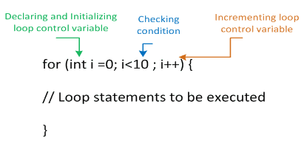
Loops
When a set of statements is executed number of times ,then it is called as a loop statement.

Slide 3
THREE TYPES OF LOOPS
While loop: Used for executing a set of statements repeatedly. The condition is tested at the beginning before entering the loop.
For loop: It executes a set of statements number of times. Here , the variable initialisation , conditional statement and the variable incrementation all takes place in a single line.
do...While loop: It executes like a while loop except that the condition is tested at the end.

Slide 4
While loop
public class WhileExample {
public static void main(String[] args) {
int i=1;
while(i<=10){
System.out.println(i);
i++;
}
}
}

Slide 5
Java do-while Loop
public class DoWhileExample {
public static void main(String[] args) {
int i=1;
do{
System.out.println(i);
i++;
}while(i<=10);
}
}

Slide 6
TASK
Write a program to print the numbers from 60 to 53 using while loop.

Slide 7
Decision Making
When a statement needs to be executed based on a condition, then if statement is used and else block will be executed when the condition is false.
There are four types of conditional statements:
if statement: First , as the program flows, the condition will be tested and then a statement or group of statements will be executed.
if-else statement: The program checks for the condition. If the condition is true ,then the if block will be executed otherwise the else block will be executed.
nested if statement: When a if statement is used within another if or elseif statement, then it is called as nested if statement.

Slide 8
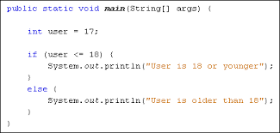
EXAMPLE

Slide 9
EXERCISE
Write a program using if else structure to find whether the number is divisible by 5 or not.

Slide 10
SOLUTION
public class Numdivby5{
public static void main(String[] args){
int num1 = 5;
if(num1 % 5 == 0)
{
System.out.println("Number is divisible by 5");
}
else
{
System.out.println("Number is not divisible by 5");
}
}}

Slide 11
Java if-else-if ladder Statement
Syntax:
if(condition1){
//code to be executed if condition1 is true
}else if(condition2){
//code to be executed if condition2 is true
}
else if(condition3){
//code to be executed if condition3 is true
}
else{
//code to be executed if all the conditions are false
}

Slide 12
Example:
//Java Program to demonstrate the use of If else-if ladder.
//It is a program of grading system for fail, D grade, C grade, B grade, A grade and A+.

Slide 13
public class IfElseIfExample {
public static void main(String[] args) {
int marks=65;
if(marks<50){
System.out.println("fail");
}
else if(marks>=50 && marks<60){
System.out.println("D grade");
}
else if(marks>=60 && marks<70){
System.out.println("C grade");
}
else if(marks>=70 && marks<80){
System.out.println("B grade");
}
else if(marks>=80 && marks<90){
System.out.println("A grade");
}else if(marks>=90 && marks<100){
System.out.println("A+ grade");
}else{
System.out.println("Invalid!");
}
}
}

Slide 14
Program to check POSITIVE, NEGATIVE or ZERO:
public class PositiveNegativeExample {
public static void main(String[] args) {
int number=-13;
if(number>0){
System.out.println("POSITIVE");
}else if(number<0){
System.out.println("NEGATIVE");
}else{
System.out.println("ZERO");
}
}
}

Slide 15
//Java Program to demonstrate the use of Nested If Statement.
public class JavaNestedIfExample {
public static void main(String[] args) {
//Creating two variables for age and weight
int age=20;
int weight=80;
//applying condition on age and weight
if(age>=18){
if(weight>50){
System.out.println("You are eligible to donate blood");
}
}
}}

Slide 16
Break statement
As the name suggests, the break statement is used to break the current flow of the program and transfer the control to the next statement outside a loop or switch statement.
However, it breaks only the inner loop in the case of the nested loop.
The break statement cannot be used independently in the Java program, i.e., it can only be written inside the loop or switch statement.

Slide 17
Continue statement
Unlike break statement, the continue statement doesn't break the loop, whereas, it skips the specific part of the loop and jumps to the next iteration of the loop immediately.

Slide 18
Switch statement
The condition will be checked and based on the condition, any one of the cases will be executed.
A break statement is used at the end of each case to exit from that block.
Default block is executed when the condition does not match any of the cases.

Slide 19
Example Program
public class Examplesw {
public static void main(String[] args) {
int choice = 1;
switch(choice) {
case 1:System.out.println("The number is one");
break;
case 2:System.out.println("The number is two");
break;
case 3:System.out.println("The number is three");
break;
case 4:System.out.println("The number is four");
break;
default:System.out.println("Choice does not match any of the case statements");
}
}
}

Slide 20
Ternary Operator
public class IfElseTernaryExample {
public static void main(String[] args) {
int number=5;
//Using ternary operator
String output=(number>5)?“number is greater than 5":“number is less than 5";
System.out.println(output);
}
}

Slide 21
Java if-else-if ladder Statement
public class BankEx {
public static void main(String[] args) {
int salary=20000;
if(salary>20000){
System.out.println(“Bank Manager”);
}else if(salary<=20000 && salary!=0){
System.out.println(“Bank Officer");
}else{
System.out.println(“Not a Bank Employee");
}
}
}

Slide 22
Nested if
public class JavaNestedIfExample {
public static void main(String[] args) {
//Creating two variables for age and weight
int age=20;
int weight=80;
//applying condition on age and weight
if(age>=18){
if(weight>50){
System.out.println("You are eligible to donate blood");
}
}
}}

Slide 23
Nested if
//Java Program to demonstrate the use of Nested If Statement.
public class NesIfEx {
public static void main(String[] args) {
//Creating two variables for age and weight
String name="";
String gender="Female";
//applying condition on age and weight
if(name == "Mala"){
if(gender == "Female"){
System.out.println("Mala is a girl");
} else{
System.out.println("Gender is not female");
}
} else{
System.out.println("Name is not valid");
}
} }

Slide 24
WHILE LOOP
public class Exampleloop {
public static void main(String args[]) {
for(int x = 1;x <= 10; x++) {
System.out.println( x );
}
int i = 90;
while(i <= 100) {
System.out.println( i );
i++;
}
int j = 20;
do
{
System.out.println( j );
j++;
}while(j <= 30);
}
}

Slide 25
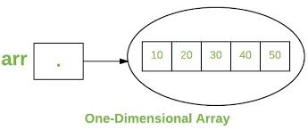
Arrays

Slide 26
ARRAY EXAMPLE
public class Exarray {
public static void main(String[] args) {
int numArr[] = new int[5];
numArr[0] = 1;
numArr[1] = 2;
numArr[2] = 3;
numArr[3] = 4;
numArr[4] = 5;
for(int i=0;i<numArr.length;i++)
System.out.println(numArr[i]);
}
}

Slide 27
Output
1
2
3
4
5

Slide 28
Multi-Dimensional Array
class Multiarrex{
public static void main(String args[]){
//declaring and initializing 2D array
int numarr[][]={{1,2,3},{4,5,6},{7,8,9}};
//printing 2D array
for(int i=0;i<3;i++){
for(int j=0;j<3;j++){
System.out.print(numarr[i][j]+" ");
}
System.out.println();
}
}}

Slide 29
Output
1 2 3
4 5 6
7 8 9

Slide 30
Exercise:
Find the error in the following code:
public class sampArr{
public static void main(String[] args){
int arr1[5] = new arr1[];
arr1[1] = 10;
arr1[2] = 11;
arr1[3] = 12;
arr1[4] = 13;
arr1[5] = 14;
for(int i=0;i<arr1;i++){
System.out.println(arr1[i]);
}}

Slide 31
Correct Code:
public class sampArr{
public static void main(String[] args){
int arr1[] = new int[5];
arr1[0] = 10;
arr1[1] = 11;
arr1[2] = 12;
arr1[3] = 13;
arr1[4] = 14;
for(int i=0;i<arr1.length;i++){
System.out.println(arr1[i]);
}}

Slide 32
Exercise:
Find the error in the following code:
public class sampArr{
public static void main(String[] args){
int arr1[5] = new arr1[];
arr1[1] = 10;
arr1[2] = 11;
arr1[3] = 12;
arr1[4] = 13;
arr1[5] = 14;
for(int i=0;i<arr1;i++){
System.out.println(arr1[i]);
}}

Slide 33
SOLUTION
public class sampArr{
public static void main(String[] args){
int arr1[] = new arr1[5];
arr1[0] = 10;
arr1[1] = 11;
arr1[2] = 12;
arr1[3] = 13;
arr1[4] = 14;
for(int i=0;i<arr1.length;i++){
System.out.println(arr1[i]);
}}

Slide 34
What is Internship????
Learn
Practice
Verify
Get Certified
Grow

Slide 35
Pantech will make you to create 6 Projects in Java in 30 Days
Objective of this 30 Days Master Class

Slide 36
1 Month Internship in Java Full Stack
INTERNSHIP E-Certificate (30Days Internship on Java Full Stack)
Highly organized Video content
Download Project Files
Download PPTs
Assignments
Weekly Hackathons
Flexible Time.
Access Period: 60Days from the date of payment
Community or Forum Support

Slide 37
What You Will Get???
Project Files of Java
30 Days Learning Practice
Servlet concepts
+ Projects
Erasure Coding(Day 25)
Public Auditing(Day 26)
Counselling Management System(Day 27)
Software Puzzle(Day 28)
Crime Management System(Day 29)
Secure Multi-Owner Data Sharing(Day 30)
Project PPT
Video Class Access for 2 Months
Get chance to Enroll 1-Month Internship on demand

Slide 38
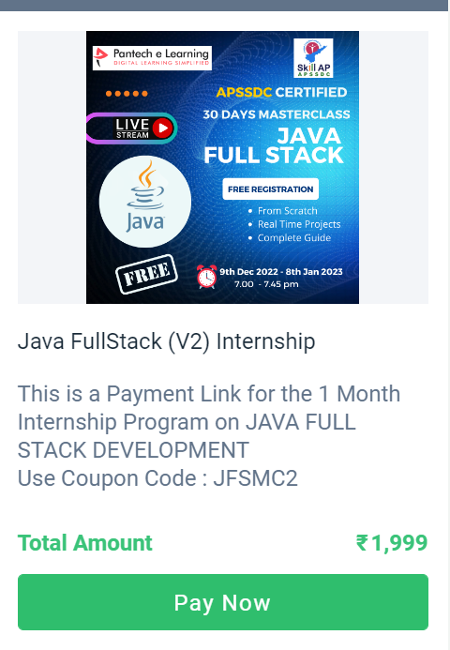
How to Enroll into 1 month Internship?
https://imjo.in/gHNkDr
REG FEE : Rs.1999 Rs.999
COUPON CODE : JFSMC2

